Slide 1
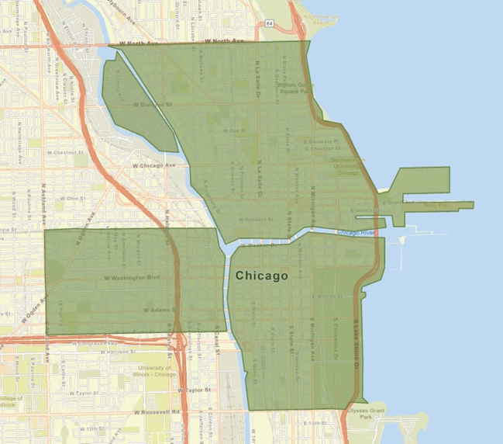
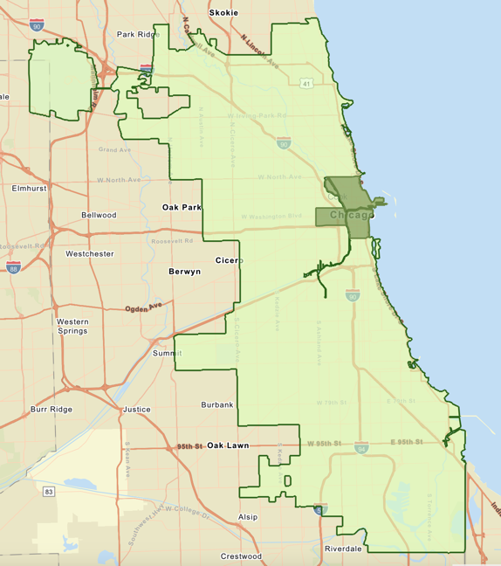
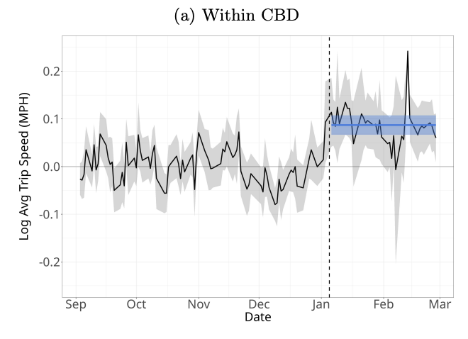
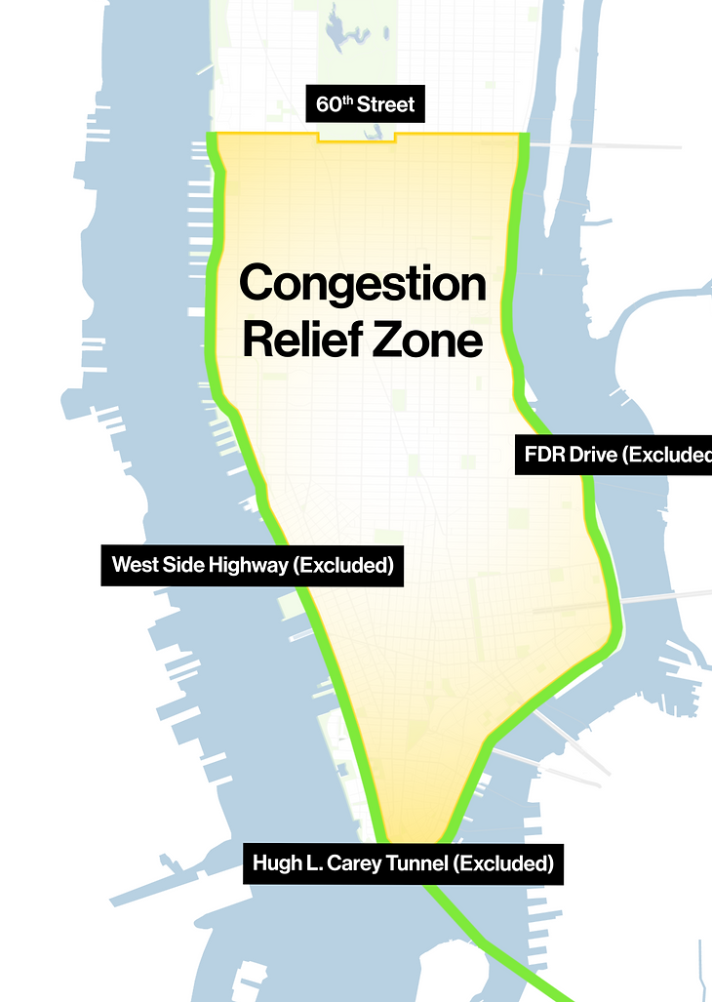
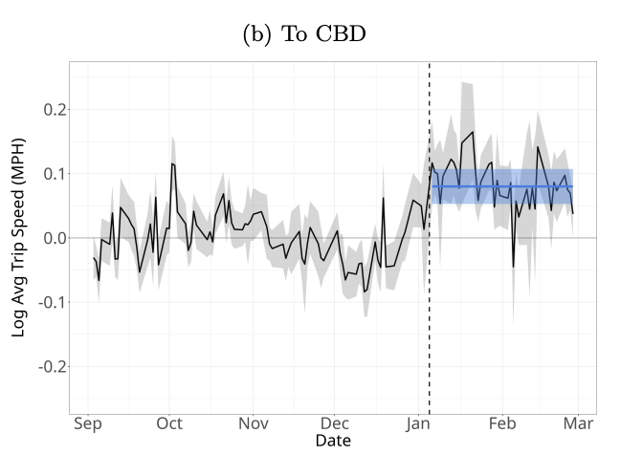
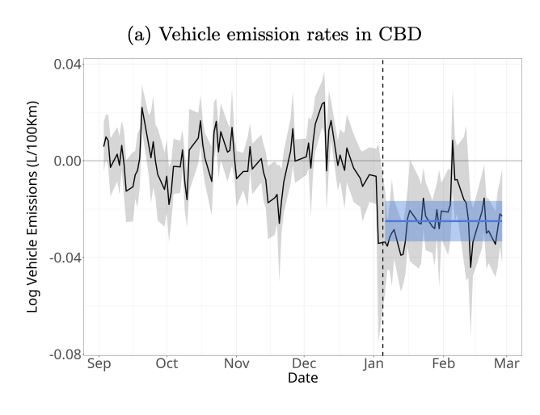
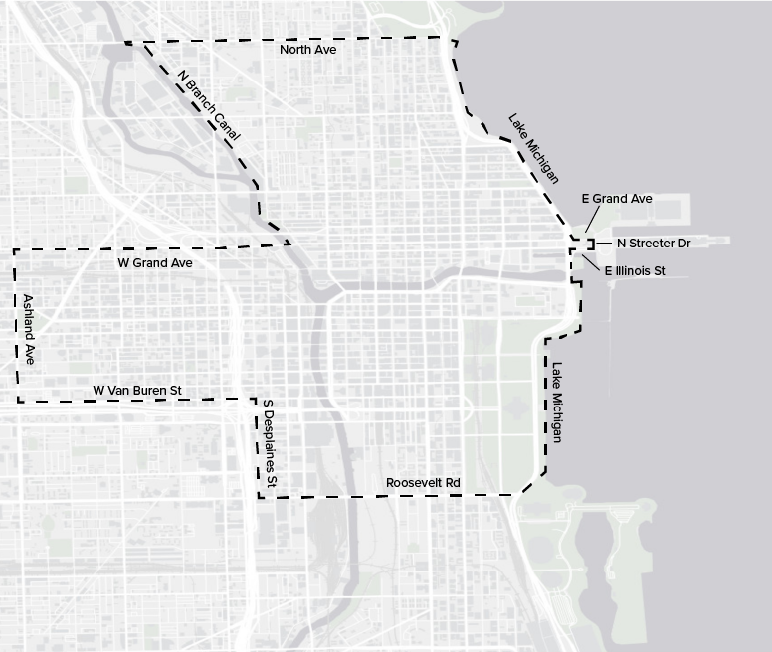
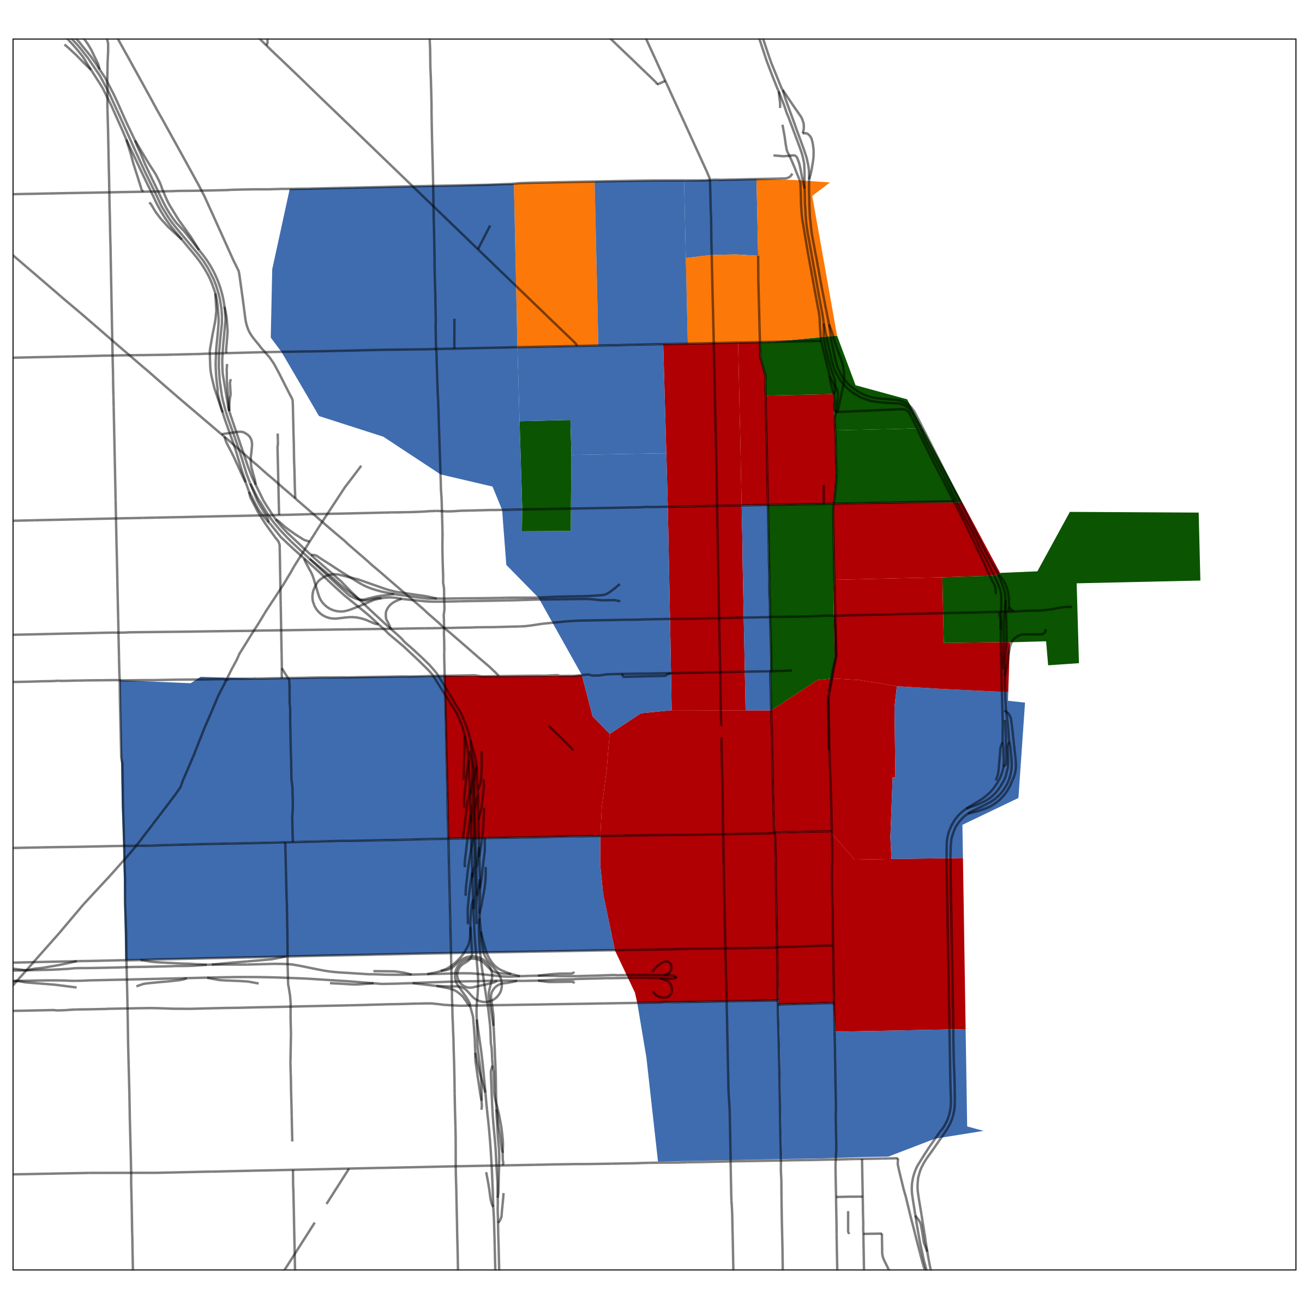
CONGESTION PRICING IN CHICAGO?
Higher Speeds, Less Noise, Lower Emissions
Willem Nienhuis | Master of Public Policy | Michigan State University
Background Research
Findings
Proposed CRZ in Chicago:
Chicago is one of the most congested cities in the United States:
  102 hours lost per driver per year,
  $6.6 billion dollars lost to the city annually
One solution that can potentially alleviate this is the creation of a Congestion Relief Zone (CRZ).
Metrics analyzed:
Methods of Transportation:
Those within the Proposed CRZ utilize mostly non-car ways to get to work.
Car use increases when expanding into the whole city and county.
Income Distribution:
Chicago and New York City have very similar income distributions.
The proposed CRZ has much higher income than the rest of the city.
  A CRZ is an area in which a toll is charged to enter, with the aim of reducing car traffic.
Notably Cities with CRZ:
  London, Milan, Singapore, Stockholm
  Most recently, New York City (pictured on the left)
Preliminary results show a moderate success in raising speeds and lowered emissions.
Funds raised from the CRZ tolls can also be put towards alternative modes of transportation, like bike paths and public transit.
New York:
Higher Speeds
Lowered Emissions
Key Metrics between Chicago and NYC CRZs
City/CRZ | Chicago | New York
Population | 186,313 | 657,738
Daytime Population | 674,082 | 2,169,489
Change in Daytime Population | 3.62x | 3.30x
Population Density (pop/mi^2) | 34,549.8 | 73,219.5
Area | ~5.4 sq. miles | ~8 sq. miles
Less Drivers in City Center
Results and Recommendations
Image Source: Metropolitan Transport Authority. (2024). Congestion pricing will unlock a better New York. Congestion Relief Zone. https://congestionreliefzone.mta.info/
Graph Source: Cook et al. (2025). The Short-Run Effects of Congestion Pricing in New York City (No. w33584; p. w33584). National Bureau of Economic Research. https://doi.org/10.3386/w33584
Similarities between Chicago and New York City suggest the addition of a CRZ could be beneficial in alleviating congestion.
  Both cities have similar flows in people travelling into their zones, with a daytime population by 3-4 times larger than the normal population.
  Both cities also have similar income distributions, indicating some degree of economic similarities.
Caveats:
  Chicago is bounded by land rather than water, and the Chicago River has many more crossings than the rivers in New York.
  The lack of natural barriers will make it more costly to construct CRZ infrastructure.
  New York also has much more public transit use to begin with, meaning it may be harder for Chicagoans to compensate for more difficulties driving into the city.
While it is hard to explicitly recommend the addition of a Congestion Relief Zone for Chicago, given the benefits and costs, it would certainly be something worthwhile for the city to take a serious look at if it can reduce congestion.
Chicago could also greatly benefit from an increase in public transportation funding, as the systems in place routinely face funding cuts from the state. Preliminary data from New York has shown that a CRZ can provide extra funds for public transportation, among other benefits like less noise and better air quality.
Additionally, Chicago already has a form of congestion charge, in the form of a surcharge on rideshare services such as Uber and Lyft.
  Rides started or ending in the zone have an extra tax added
  Pickups and drop-offs ended reduced by around 7%
Method of Commute within Chicago CRZ
g Walked
g Worked from Home
g Drove Alone
g Public Transportation
Methodology
Firstly, a proposed Congestion Relief Zone for Chicago must be created.
  A zone roughly matching the existing rideshare congestion zone was used, aligning with census tracts to make data collection easier.
  Not all data is available at the tract level, so there is some natural limitations to what can be measured in the zone specifically
Certain metrics, such as methods or transportation and income, will be compared between New Yorks existing CRZ and the proposed Chicago CRZ to see if a similar congestion pricing scheme could be implemented.

